Slide 1
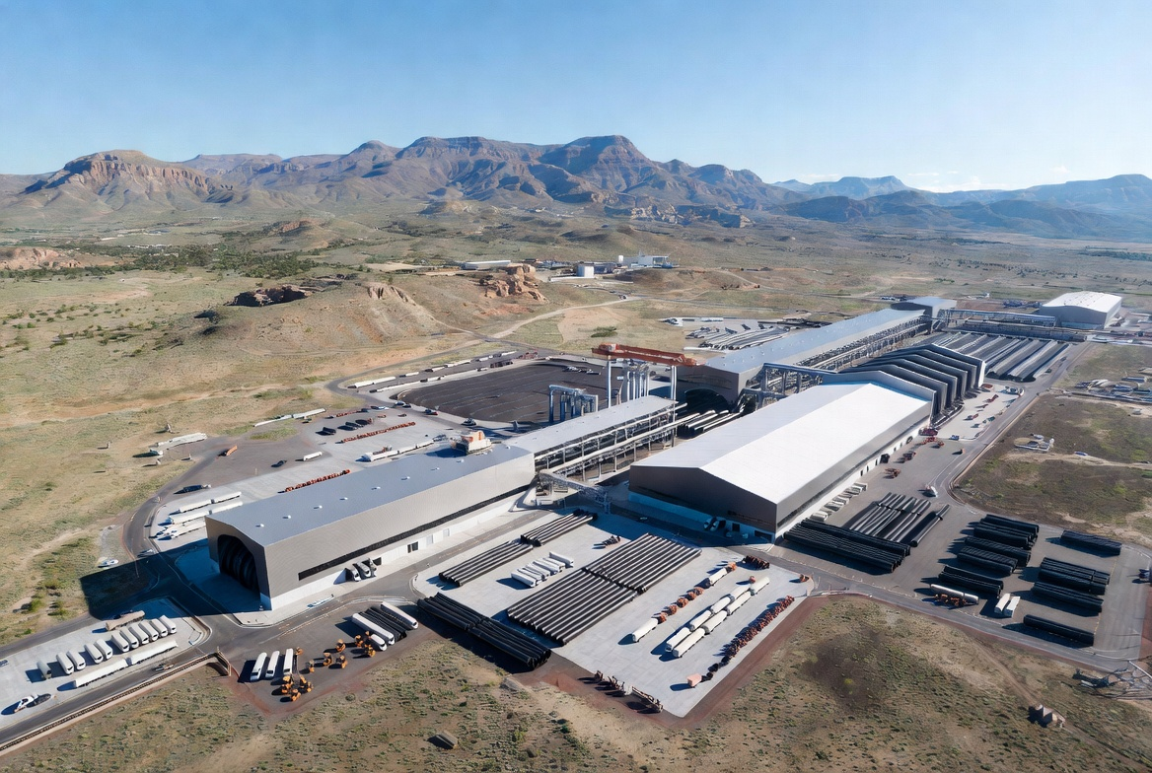
READY FOR LAUNCH
Careers at New Mexico Steel Pipe
Building the pipes that will carry New Mexico's water —
and the careers that go with them
Juniors & Seniors
Edgewood, New Mexico
~215 permanent jobs
NM Pipe, LLC · Juniors & Seniors Career Presentation

Slide 2
WHY THIS MATTERS
New Mexico's Water Opportunity
Statewide water transmission needs + local manufacturing = lasting careers near home
WATER PROJECTS NEED PIPE
CAREERS THAT STAY LOCAL
New Mexico Strategic Water Supply
~215 permanent jobs at full production — Production, trades, QA, Maint & Leadership
Major in-state transmission corridors
Ute Lake / Eastern NM
Wages, suppliers, and careers stay in the Edgewood / Albuquerque-east corridor.
Regional supply & transmission
Salt Basin / southern NM
WHY A FACTORY HERE
Long-term resource development
Edgewood sits between major in-state corridors and regional demand — close enough to serve NM projects without long haul freight.
Nutt-Hockett & local systems
Community and agricultural supply
NM Pipe, LLC · Edgewood, New Mexico
2 / 12

Slide 3
EDGEWOOD CAMPUS
The Plant We Are Building
1
2
3
20"–84" Diameter
Spiral-Weld Steel
Mortar Lined · PU Coated
Large-diameter water transmission pipe
Precision formed from coil & plate
Cement-mortar interior, polyurethane exterior
4
5
6
QA / QC Inspection
Lengths up to 52 ft
High-Tech New Facility
Dimensional, NDT, and pressure tested
Long joints — fewer field welds
Modern, automated Edgewood plant
NM Pipe, LLC · Edgewood, New Mexico
3 / 12

Slide 4
HOW PIPE IS MADE
Inside the Plant — Technology Walk-Through
1
2
3
4
Coil & Plate
Form & Spiral Weld
Expand / Bevel Ends
Hydrotest
Steel coil staged for forming
Continuous spiral seam welding
Bell, spigot & end prep
Full-length pressure test
5
6
7
8
Mortar Lining
Blast + PU Coat
Final QA
Load & Ship
Cement-mortar interior
Exterior protection system
NDT, dims, documentation
Flatbed delivery to site
NM Pipe, LLC · Edgewood, New Mexico
4 / 12

Slide 5
BE READY WHEN IT COUNTS
Hiring Ramp
Few hires for ~18 months while we build — then 200+ roles in a 6–9 month wave to ~215 permanent jobs
Phase 1 · Build
Phase 2 · Ramp
Phase 3 · Steady State
~18 months
6–9 months
Full production
• Engineering, permits, groundbreaking
• Single-shift into double-shift production
• ~215 permanent careers on site
• Construction of the Edgewood plant
• 200+ openings across all families
• Ongoing training and advancement
• Small core staff & early leadership
• Helpers, operators, techs, QA, logistics
• Replacement and growth hiring
• Equipment install & commissioning prep
• Supervisors and specialists hired
• Long-term local manufacturing base
• Your window to train and get ready
• Applications matter most in this window
• Careers that stay in the community
NM Pipe, LLC · Edgewood, New Mexico
5 / 12

Slide 6
WHERE YOU CAN START
Career Families & Entry Points
Direct Production
Maintenance & Tech
Quality & Safety
Helpers · operators · welders · liner/coat crews
Mechanical · electrical · hydraulic · PLC/drives
QA/QC · NDT · dimensional · HSE roles
Start → Grow: Helper → Operator → Lead
Start → Grow: Helper → Tech → Multi-skill
Start → Grow: Clerk → Inspector → Lead
Logistics & Support
Supervisory Track
Professional
Yard · forklift · rail crane · material handling
Crew leaders · shift / area supervisors
Engineering · purchasing · finance · HR · IT
Start → Grow: Yard → Equipment → Lead
Start → Grow: Lead → Supervisor → Manager
Start → Grow: Coord → Specialist → Manager
NM Pipe, LLC · Edgewood, New Mexico
6 / 12

Slide 7
PAY THAT COMPETES
Realistic Compensation & Benefits
Total annual opportunity at full production (base + typical OT). Hourly shown is base.
ANNUAL OPPORTUNITY BANDS
BENEFITS WE'RE BUILDING
Entry · helpers & trainees
$65K – $75K
Safety-first culture
PPE, training, go-home-whole design
Helper $20–24/hr · Utility $22–26/hr · QA clerk $21–25/hr
Health & wellness
Medical, dental, vision, life + FSA
Skilled operators
$80K – $100K
Retirement growth
401(k) + profit-sharing (eligibility)
Line ops $28–34/hr · Weld repair $30–36/hr · Hydro/coat $29–35/hr
Overtime opportunity
Weekly pay; OT under NM law
Advanced tech & leads
$95K – $140K
Training & growth
Welding, equipment, PLC, NDT
Electrician $36–48/hr · PLC $38–52/hr · NDT/crane lead $35–50/hr
Vacation & holidays
5→20 days by tenure
Supervisors & pros
$140K+
Bonus incentives
STIP / LTIP for key positions
Shift supervisor · Managers & engineering (market + STIP)
Family culture
Family owned & operated
NM Pipe, LLC · Edgewood, New Mexico
7 / 12

Slide 8
BUILD THESE NOW
Skills That Give You an Edge Right Now
1
Safety + reliability
2
Trades basics
3
Tech curiosity
Non-negotiable for every role
Weld, tools, equipment awareness
PLC, measuring, certs that stack
Must-have
Must-have
Must-have
Trades
Trades
Safety mindset
Show up reliable
Team communication
Mechanical curiosity
Welding & metal fab
See hazards early, follow PPE, speak up
On time, every shift — #1 hire signal
Clear handoffs and respect under pressure
Tools, fasteners, how machines move
Basics put you ahead for specials
Trades
Tech
Tech
Tech
Must-have
Equipment & yard
Controls & PLC
Math & Science
Certificates that stack
Professional presence
Forklift, rigger awareness, spatial judgment
Screens, sensors, drives — modern plants
Decimals, drafting, materials, QA/QC
OSHA-10, first aid, forklift, welding
Resume, interview, drug-free, coachable
NM Pipe, LLC · Edgewood, New Mexico
8 / 12

Slide 9
YOUR ACTION PLAN
How to Prepare This Year & Next
THIS YEAR
What to do before graduation
NEXT
After high school · stay in range
1
Meet your counselor
Local training pipeline
Share industrial production, welding, maintenance, logistics, QA. Ask for CTE and dual-credit.
ABQ & Edgewood-area trade/tech schools, CNM, universities for the professional ladder.
2
Take the flyer home
Stay local, stay ready
Keep the NMSP handout. Talk with family about timeline and skills.
Communities within ~20 miles of Edgewood — build a reputation before the hire wave.
3
Pick classes that count
Stay connected
Shop, welding, auto/ag mech, geometry, drafting/CAD, computer systems.
Plant tours, info nights, application windows as funding and groundbreaking firm up.
4
Stack one cert
Time your prep
OSHA-10, first aid/CPR, forklift when eligible, intro welding ticket.
Build phase = prep window. Ramp = when applications matter most.
5
Stay balanced
Research best paths
Work experience, sports, extracurriculars — employers notice well-rounded students.
Compare CTE, apprenticeships, dual-credit, trade school, CNM/university routes.
NM Pipe, LLC · Edgewood, New Mexico
9 / 12

Slide 10
WHO WE ARE BECOMING
Culture, Safety & Community
"Safe. Skilled. Local. Building water infrastructure New Mexico can count on."
That's the standard for every shift — from helper to supervisor.
Safety first — always
Continuous training
Respect & teamwork
Modern processes, PPE, stop-work authority. No job is worth a shortcut.
Grow on the job — equipment, welding, QA, maintenance, leadership.
Show up ready, help your crew, communicate clearly.
Local community first
Meaningful work
Modern, responsible plant
Edgewood & ABQ-east. Wages and careers stay within ~20 miles.
Pipe that carries water for NM families, farms, and cities.
New facility, efficient processes, long-term manufacturing base.
NM Pipe, LLC · Edgewood, New Mexico
10 / 12

Slide 11
LEAVE READY
Next Steps
Four moves. Do these and you'll be ahead when New Mexico Steel Pipe starts hiring for real.
1
Take the flyer
TODAY
2
Talk to your counselor
THIS WEEK
Detailed handout with roles, timeline, and prep tips. Keep it. Share it with family.
Map Career and Technical Education (CTE), dual-credit, and cert options to the career family you want.
3
Choose your skill plan
THIS SEMESTER
4
Watch for announcements
ONGOING
One must-have, one trade skill, one cert. Start this semester — don't wait for a posting.
Tours, info nights, and the hiring wave after the plant is built. Stay local and ready.
Remember: few hires for ~18 months while we build — then 200+ roles in a 6–9 month wave. Prep now · apply later.
NM Pipe, LLC · Edgewood, New Mexico
11 / 12

Slide 12
OPEN FLOOR
Questions?
Anything about the plant, careers, technology, pay, or how to get ready — ask us.
There are no bad questions.
The plant & process
Jobs & pay
Technology & skills
How to prepare
AFTER TODAY
• Take the flyer · talk to your counselor
• Start your skill plan this semester
• Watch for tours and hiring announcements
NM Pipe, LLC · Edgewood, New Mexico
~215 permanent careers · Water Infrastructure for New Mexico

